Slide 1
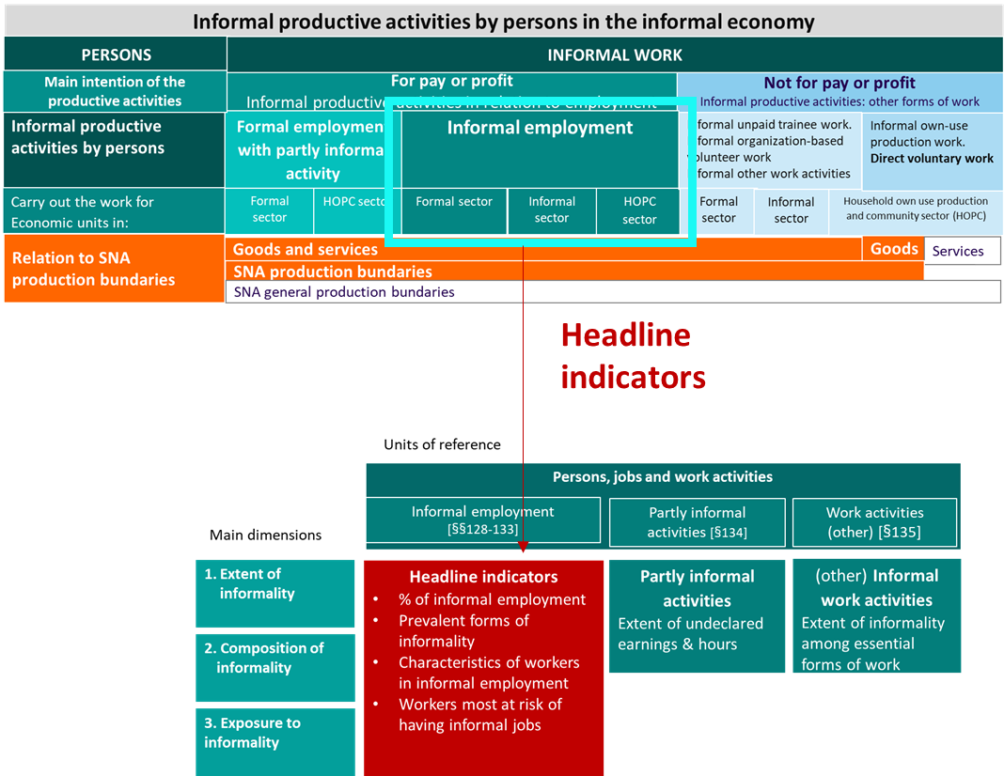
Session 3.1
Going from derived variables to indicators on persons, jobs and work activities
Focus on headline indicators
ILO-SIAP Regional Course on Statistics on Informality: Definitions, Measurement, SDGs and Other Policy Indicators
Chiba (Japan), 15-18 October 2024
+
Florence Bonnet AP/FORMALIZATION (bonnet@ilo.org

Slide 2
Scope of the session

Slide 3
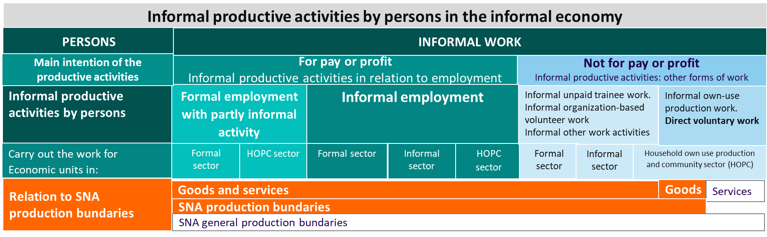
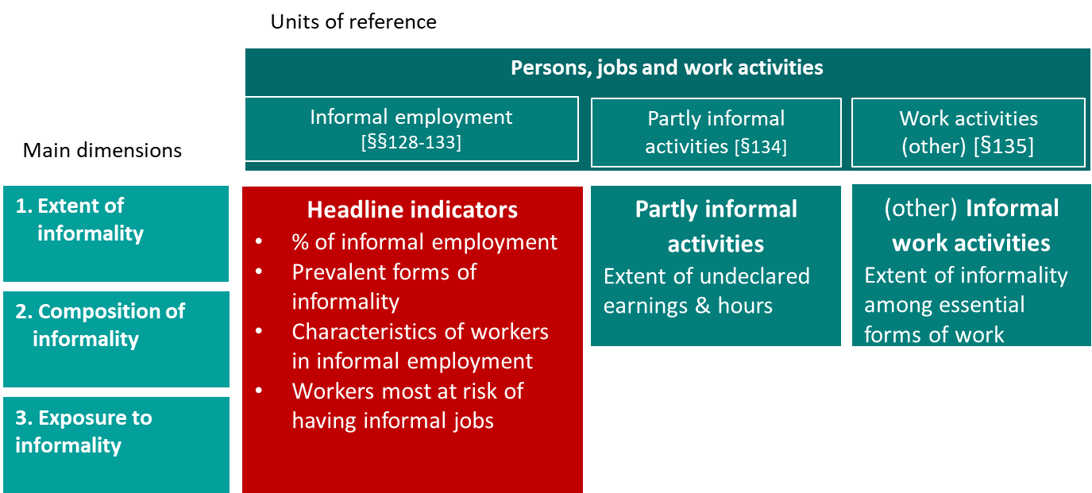
Introduction | A primary focus on headline indicators (1)
    Among indicators referring to “persons/jobs and work activities” headline indicators are about persons in “informal employment” in their main job
    Headline indicators aim to answer to the following questions — which are also the first 3 dimensions of the indicator framework:
      What is the extent of informal employment?
      What is/are the prevalent forms of informal employment?
      Who are the workers in informal employment and to what extent their profile differ from workers in formal employment? (composition of informal compared to formal employment)?
      Who are the workers the most exposed to the risk of informality?
Headline indicators

Slide 4
Introduction | A focus on headline indicators (2)
    Those questions not only contribute to describe workers with informal and formal main jobs and understand the diversity of situations but already support policy development:
      allow for the identification of priority groups if any as part of the process of addressing the challenges associated to informality and support formalization processes
      Contribute to the identification of some of the drivers of informality: those associated to socio-demographic and employment related features
    Recommended source: All the proposed headline indicators can be produced from a typical labour force survey
    Frequency: Countries are encouraged to produce those indicators with a regular frequency for example at quarterly or yearly intervals

Slide 5

1st question |
What is the extent of informal employment?
Dimension 1.
Extent of informality

Slide 6
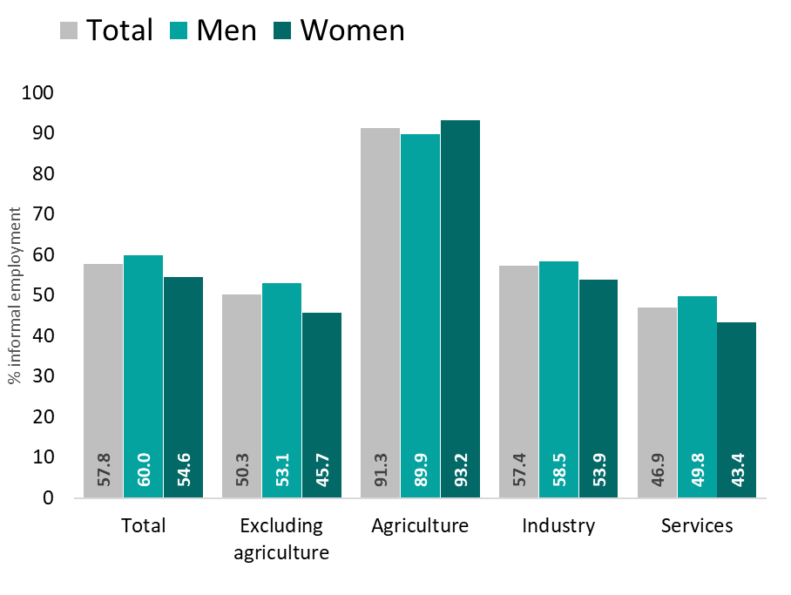
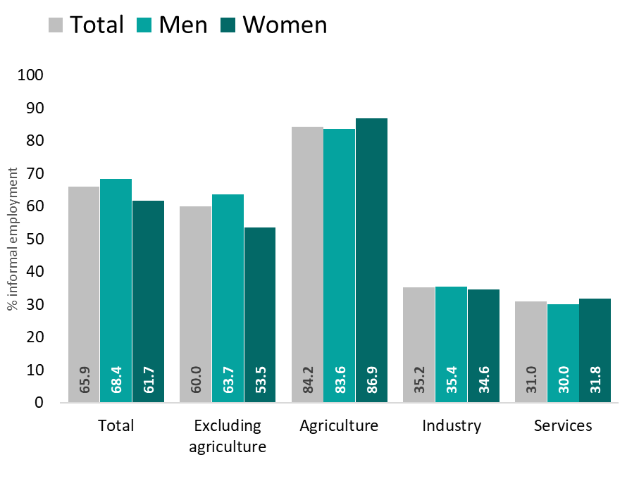
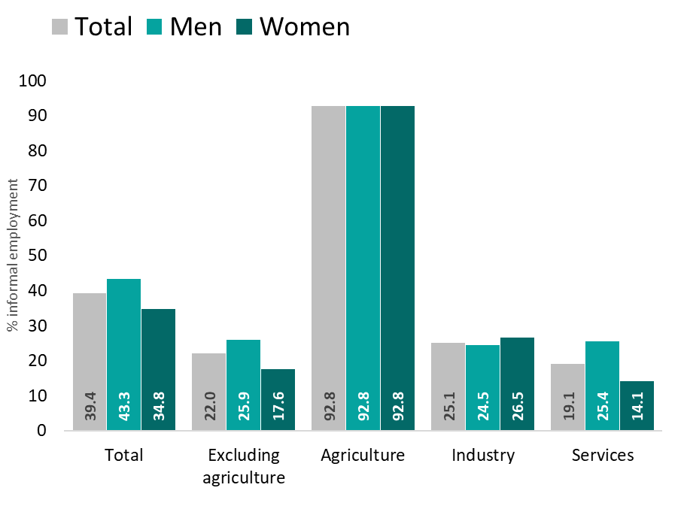
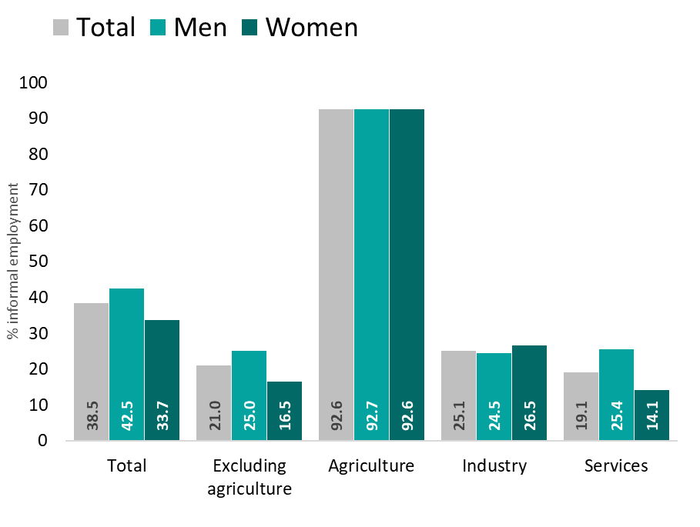
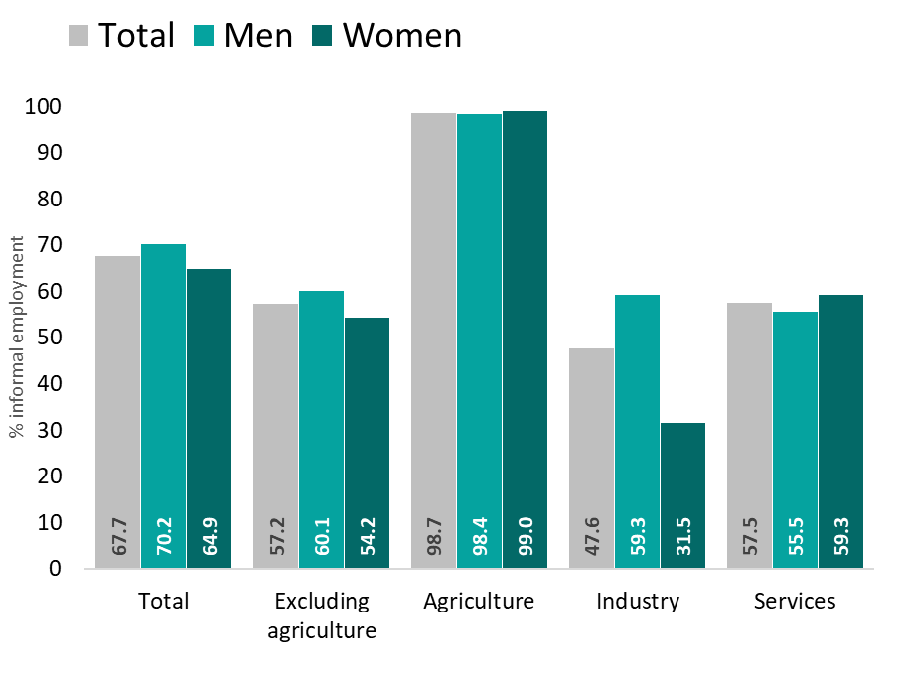
Percentage of informal employment by economic activity and by sex
Headline
128a
Global | Percentage of informal employment in relation to total employment, by economic activity by sex (%, 2019)
Asia and the Pacific | Percentage of informal employment in relation to total employment, by economic activity by sex (%, 2019)
Mongolia| Percentage of informal employment in relation to total employment, by economic activity by sex (%, 2023)
Viet Nam| Percentage of informal employment in relation to total employment, by economic activity by sex (%, 2023)
Indicator
  128a. Number of persons with an informal main job and the percentage of informal main jobs in relation to total employment, by economic activity and by sex [SDG 8.3.1]
Main dimensions
19e ICLS
1. Extent of informality
13e ICLS
1. Extent of informality
2. Composition of informality
3. Exposure to informality
For specific country data, see indicator 1 in country profiles
4. Working conditions & productivity
5. Contextual vulnerability
6. Other structural factors
Source: ILO 2023. Women and men in the informal economy: A statistical update

Slide 7
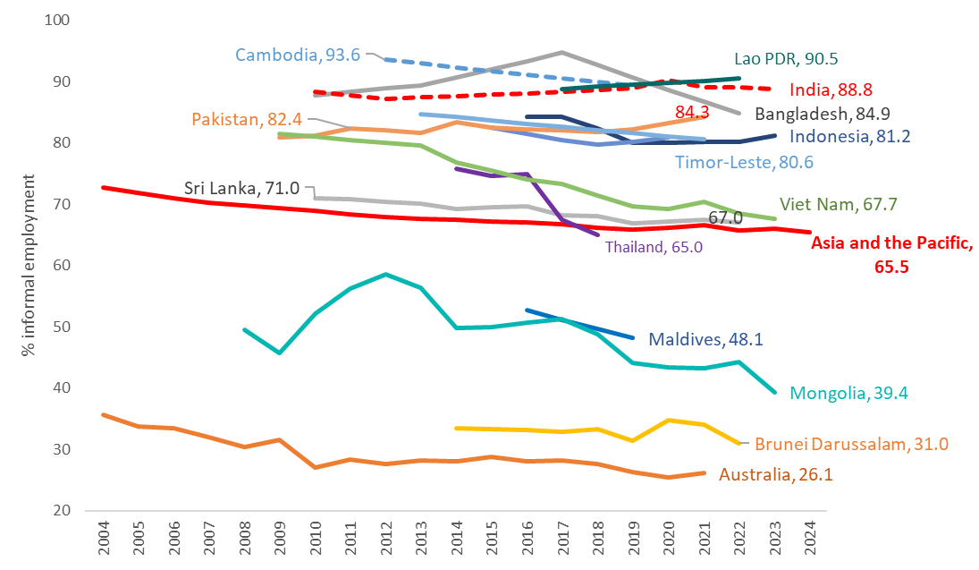

Headline
Would you say that informal employment increases or decreases in your country?
128a
Proportion of informal employment as a % of total employment
A synthetic measure….
… if not complemented by additional indicators, does not really provide useful elements to understand the diversity of situations and needs in the informal economy to effectively support the development of policies and interventions to improve the situation
Has the share of informal employment in total employment increased or decreased in recent years in your country?
Source: ILOSTAT - ILO calculations based on household survey micro datasets; and ILOSTAT modelled data for Asia and the Pacific (regional average)

Slide 8
2nd question |
What is/are the prevalent ‘form(s)’ of informality in the country?
Dimension 2. Composition of informality

Slide 9
Question 2 | Prevalent forms of informal employment
Headline
128b
    Part of the second dimension: Composition of informality
          “Prevalent form of informality” is about the composition of informal employment by type of production unit (informal sector, formal sector, households own-use production and community sector) and status in employment
          Given the definition of informal employment, formalization processes will already involve different policy mix for each of the categories of workers identified on this basis
          To be complemented with a 3rd question about the characteristics of those most represented among workers in informal employment
Main dimensions
1. Extent of informality
2. Composition of informality
2. Composition of informality
3. Exposure to informality
4. Working conditions & productivity
5. Contextual vulnerability
6. Other structural factors

Slide 10
Question 2 | Prevalent forms of informal employment
What formalization means for who?
Headline
128b
Formalize jobs among employees
Informal employment
Formalize enterprises as a necessary condition
Formalize jobs
FORMAL SECTOR
Employees in
informal employment in the formal sector
Employees in informal employment in the informal sector
INFORMAL SECTOR
Formalization of enterprises (& jobs for independent workers)
Registration and legal recognition of the economic unit and compliance with fiscal, labour and social obligations
considered as a necessary condition to engage in transactions, enter into contracts, incur liabilities, access finance without engaging their own risk
Sustainability and ability to provide decent working conditions (for the owner and employees)
May require
  the extension of the scope of fiscal, labour & social security regulation to all enterprises without exception
  should be accompanied with measures to tackle the root causes of informality including to enhance productivity, capacity & willingness, etc.
Formalize jobs among dependent contractors
Formalize enterprise/ activity as a necessary condition
Formalize jobs
Dependent contractors in informal employment in the formal sector
Dependent contractors in informal employment in the informal sector
Formalization of jobs for employees
About the effective access to adequate job-related social and labour protections
May require
  the extension of legal coverage (scope of social security & labour laws) to workers not yet covered
  the provision of adequate level of legal protection
  the recognition and the declaration of the employment relationship by the employer
  necessary conditions but not sufficient
  What matters is the effective access to “employment related” social and labour protections
Formalize enterprises
Access to formal protection where they exist
Reduction of decent work deficits
Shift to the status of employees
Independent workers in the
informal sector
Formalize enterprises
 decent work deficits
Shift to employee status
Contributing family workers in the formal sector
Contributing family workers in the informal sector
Domestic employees who have informal
Jobs
Own account workers in households producing exclusively for own
final use
-
Formalize jobs among employees (domestic workers)
Reducing work deficits
Supporting access to market production
HOUSEHOLDS

Slide 11
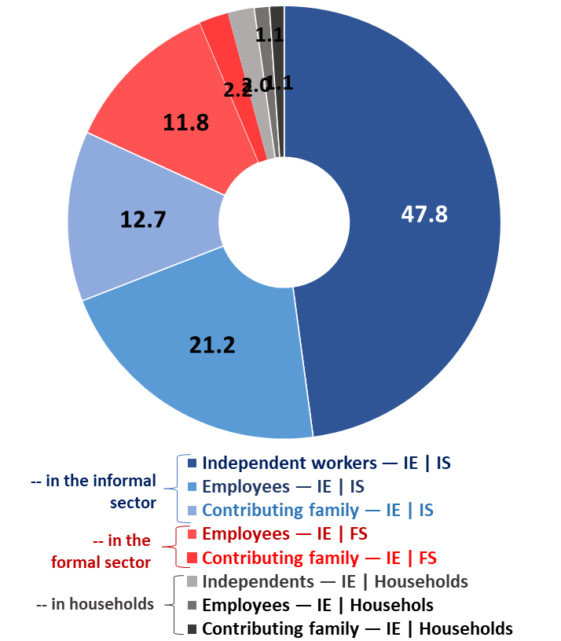
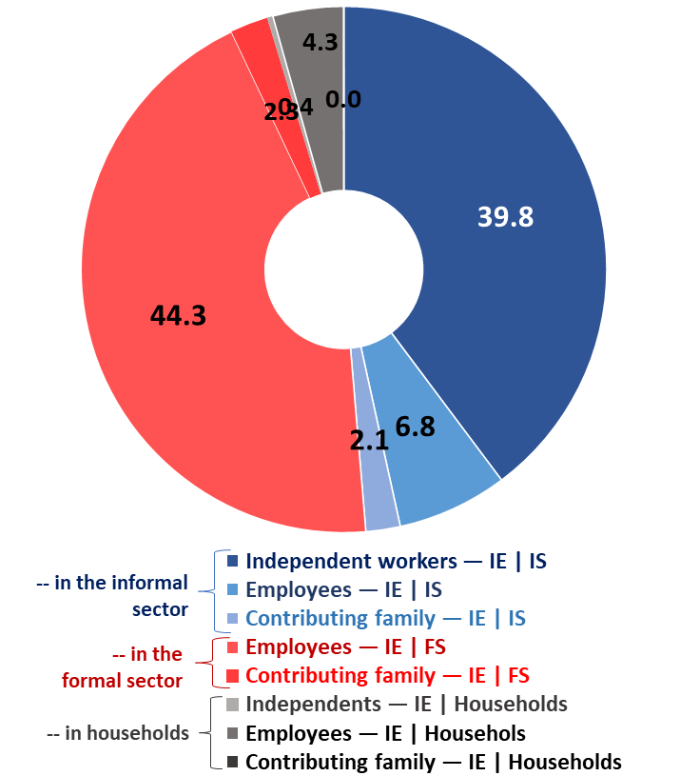
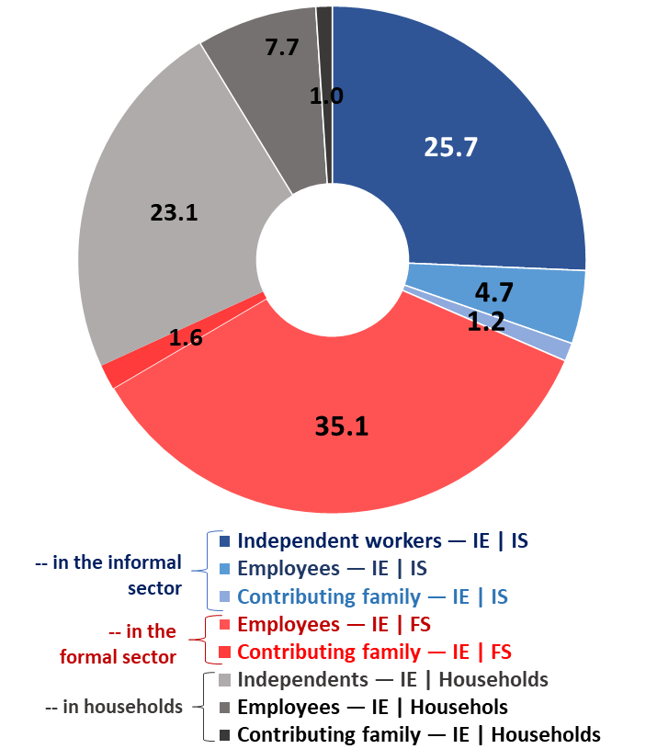
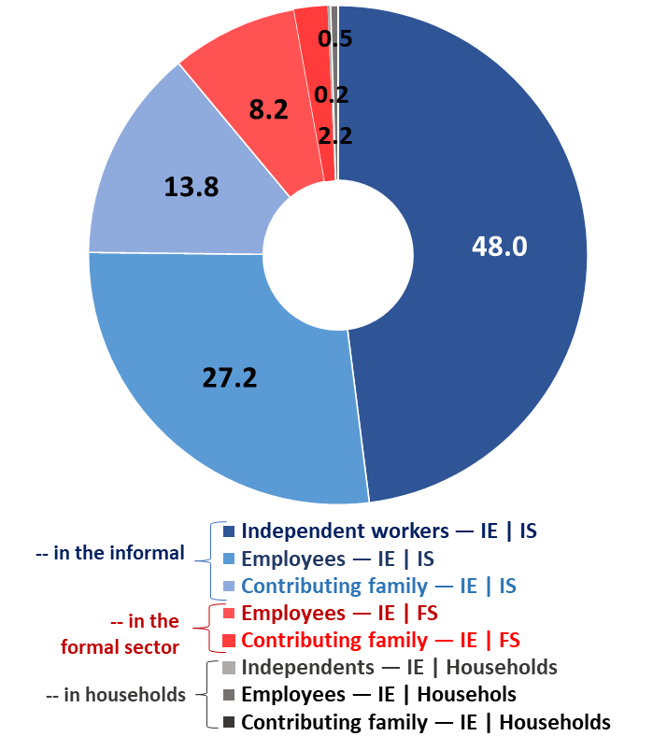
Question 2 | Prevalent forms of informal employment
Examples from countries
Headline
128b
Indicator
  §128b Distribution of persons with an informal main job by informal sector, formal sector, household own-use production and community sector and status in employment and by sex
Main dimensions
1. Extent of informality
2. Composition of informality
2. Composition of informality
3. Exposure to informality
Source: ILO 2023. Women and men in the informal economy: A statistical update for regional estimates & ILO calculatiions based on national sruvey data (ILOSAT)
Asia and the Pacific | Distribution of informal employment by informal sector, formal sector, household own-use production and community sector and status in employment (%, 2019)
Viet Nam| Distribution of informal employment by informal sector, formal sector, household own-use production and community sector and status in employment (%, 2023) [19e ICLS]
Maldives| Distribution of informal employment by informal sector, formal sector, household own-use production and community sector and status in employment (%, 2019) [19e ICLS]
Maldives| Distribution of informal employment by informal sector, formal sector, household own-use production and community sector and status in employment (%, 2019) [13e ICLS]
4. Working conditions & productivity
For specific country data, see indicator 2 in country profiles
5. Contextual vulnerability
6. Other structural factors

Slide 12
Dimension 2. Composition of informality
3rd question. Who are the workers the most represented in informal employment?
Dimension 3. Exposure to informality
4th question. Who are the most exposed to the risk of informality?

Slide 13
Question 3 | Who are the workers the most represented among workers in informal and formal employment?
Headline
128b
B. Composition of informality
Objectives
  Identify workers most represented among workers in informal and formal employment — the largest groups (in numbers) but also those that are over-represented in informal employment compared to their representation in total employment or in formal employment
  Important to compare the distribution of workers in informal employment compared to those in formal employment
  Can support agreement on priority groups for policy interventions
Indicators
  128c) Distribution of persons with an informal or formal main job by socio-demographic characteristics and employment-related characteristics and by sex
Main dimensions
1. Extent of informality
Reminder — Recommended disagregation for Indicators related to persons and jobs by refer notably to:
  Sex and other relevant socio-demographic characteristics, including by age, educational level, area of residence (urban or rural) and geographical region.
  Employment-related characteristics, including: status in employment, economic activity, occupation, place of work, size of enterprise, duration of the employment agreement and number of hours worked (hour bands).
2. Composition of informality
2. Composition of informality
3. Exposure to informality
4. Working conditions & productivity
5. Contextual vulnerability
6. Other structural factors
*

Slide 14
Question 4 | Who are the workers the most exposed to the risk of having an informal job?
Headline
128b
C. Exposure to informality
Objectives
  Identifies groups that are particularly exposed to informality, i.e., not necessarily the largest group in numbers but with an incidence of informality higher than average
  Points out to drivers of informality associated to socio-demographic and employment-related features
  Can support agreement on priority groups for policy interventions
Indicators
  128d. Percentage of employed persons with an informal main job by socio-demographic and employment-related characteristics and by sex
Main dimensions
1. Extent of informality
2. Composition of informality
2. Composition of informality
3. Exposure to informality
4. Working conditions & productivity
Through key socio-demographic & employment-related features, important to identify specific groups at high risk of informality such as domestic workers, home-based workers, workers with disabilities, etc.
5. Contextual vulnerability
6. Other structural factors
*

Slide 15
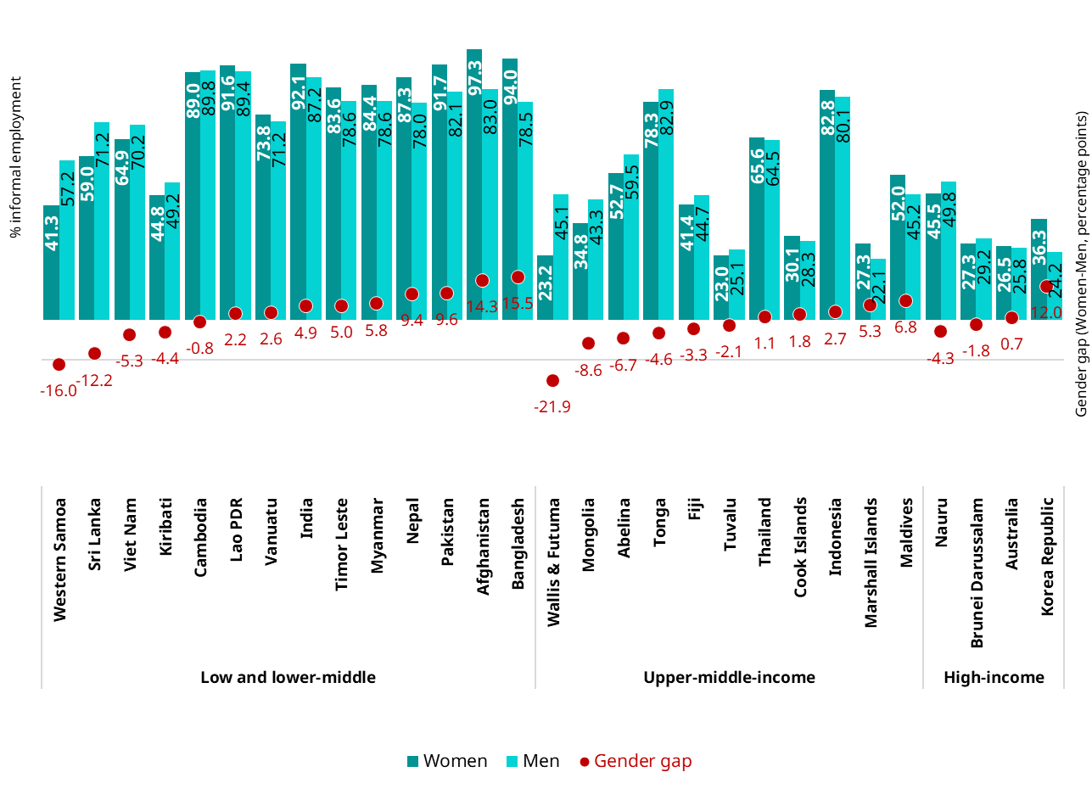



According to you, who are the workers the most exposed to and/or the most represented in informal employment (world, region or country)?
 | World |  | Region
Informal employment is… | True | False | True | False
A greater source of employment for women than for men
Higher among young workers and senior workers
Null or negligible among high educated workers
The informal economy tends to absorb people with low-education
Higher among independent workers compared to wage workers
Independent workers make up the majority of informal employment
Workers in large enterprises are “safe” & protected against the risk of being informally employed
Agriculture, domestic work & construction tend to be highly informal
Share of informal employment by sex (% 2019)
68.4%
60.2%
55.2%
61.7%
Asia & the Pacific
World
See indicator 1 in Country profiles
3. Exposure to informality

Slide 16
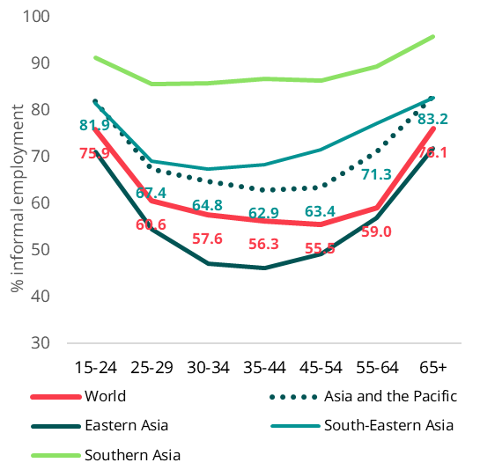
According to you, who are the workers the most exposed to and/or the most represented in informal employment (world, region or country)?
 | World |  | Region
Informal employment is… | True | False | True | False
A greater source of employment for women than for men
Higher among young workers and senior workers
Null or negligible among high educated workers
The informal economy tends to absorb people with low-education
Higher among independent workers compared to wage workers
Independent workers make up the majority of informal employment
Workers in large enterprises are “safe” & protected against the risk of being informally employed
Agriculture, domestic work & construction tend to be highly informal
Incidence of informal employment by age (World, Asia and the Pacific and subregions)

See indicator 12 in Country profiles
3. Exposure to informality

Slide 17
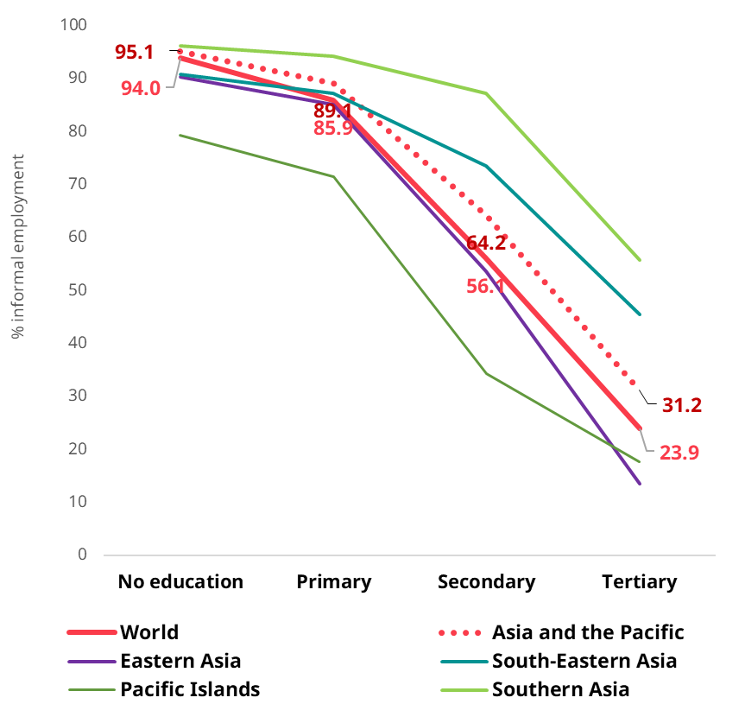
According to you, who are the workers the most exposed to and/or the most represented in informal employment (world, region or country)?
 | World |  | Region
Informal employment is… | True | False | True | False
A greater source of employment for women than for men
Higher among young workers and senior workers
Null or negligible among high educated workers
The informal economy tends to absorb people with low-education
Higher among independent workers compared to wage workers
Independent workers make up the majority of informal employment
Workers in large enterprises are “safe” & protected against the risk of being informally employed
Agriculture, domestic work & construction tend to be highly informal
Share of informal employment in total employment by level of education | (World, Asia and the Pacific) [1]
See indicator 13 in Country profiles
3. Exposure to informality

Slide 18
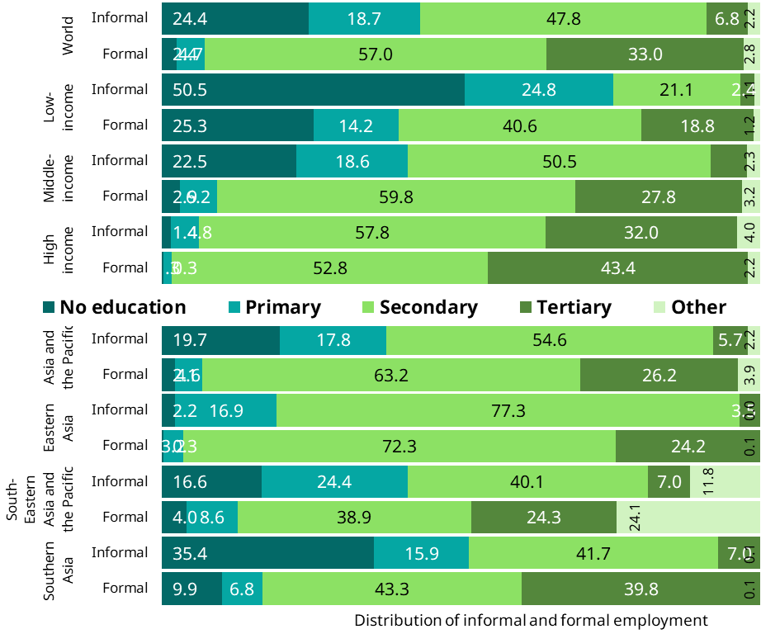
According to you, who are the workers the most exposed to and/or the most represented in informal employment (world, region or country)?
 | World |  | Region
Informal employment is… | True | False | True | False
A greater source of employment for women than for men
Higher among young workers and senior workers
Null or negligible among high educated workers
The informal economy tends to absorb people with low-education
Higher among independent workers compared to wage workers
Independent workers make up the majority of informal employment
Workers in large enterprises are “safe” & protected against the risk of being informally employed
Agriculture, domestic work & construction tend to be highly informal
Up to 43 per cent of informal workers have at best a primary level of education compared to 7 per cent among workers in formal employment
10% of workers in formal employment have either no or a primary education at best; and over 1/3 have a tertiary level
Distribution of formal and informal employment by level of education | (World, Asia and the Pacific) [2]
In high-income countries the educational profiles are not so different between workers in informal and formal employment — Secondary & tertiary education is the norm and up to one of three workers in informal employment have a tertiary level
In Asia and the Pacific, 37% of informal workers have no or a primary level of education; this proportion reaches more than half of informal workers in Southern Asia
See indicator 5 in Country profiles
2. Composition of informality

Slide 19
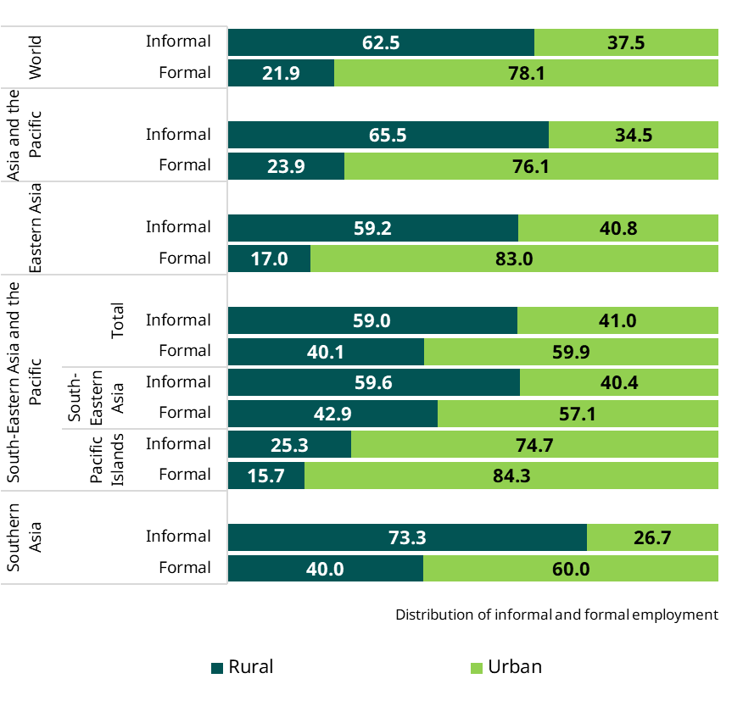
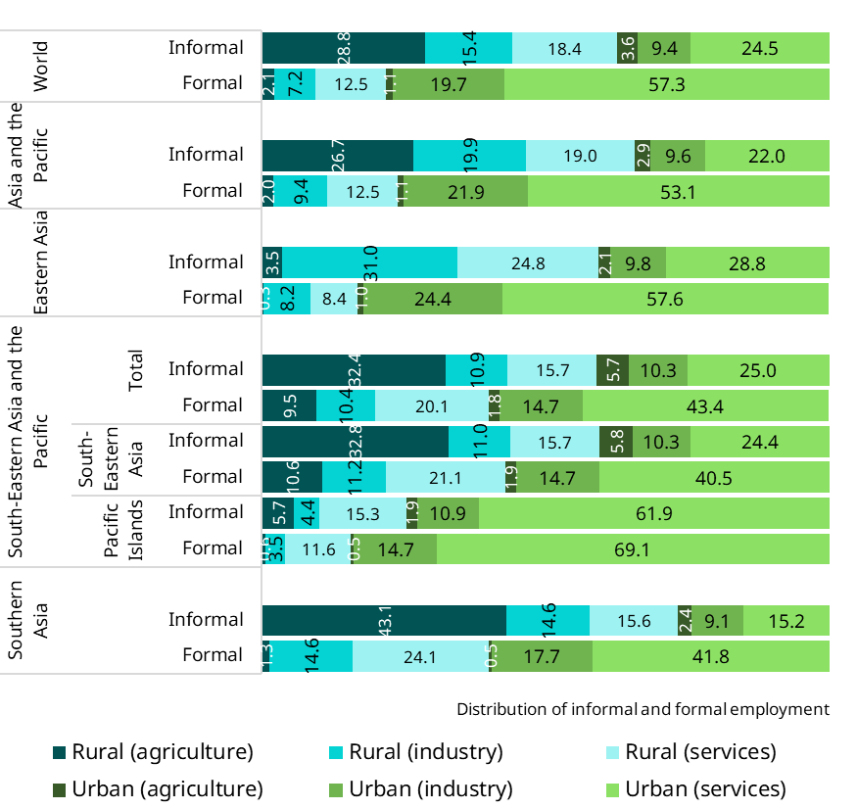
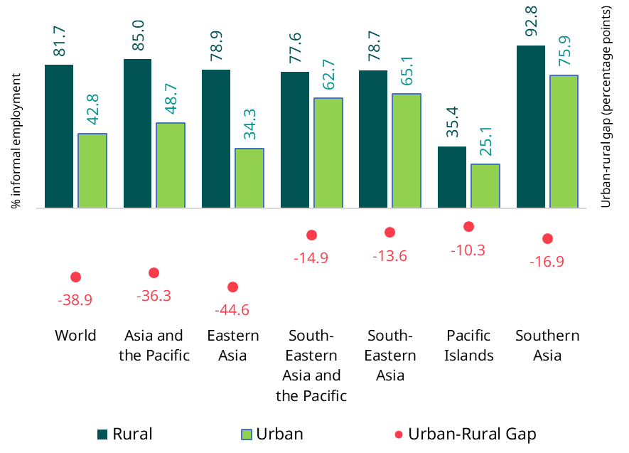
A share of informal employment 2 times higher in rural areas
3. Exposure to informality
2. Composition of informality
World: More than 60% of the workers in informal employment live /work in rural areas, many in agriculture; by contrast, close to 80% of those in formal employment are in urban areas
The same trend can be observed in Asia; the only exceptions are the Pacific islands.
Share of informal employment as a proportion of total employment by urban / rural (2019)
Distribution of informal & formal employment by urban / rural (2019)
World: A proportion of informal employment which is close to 2 times higher among workers in rural areas
The ratio is just slightly lower for Asia and Pacific as a whole but the highest in Eastern Asia.
See indicators 6 (composition) & 14 (exposure) in country profiles

Slide 20
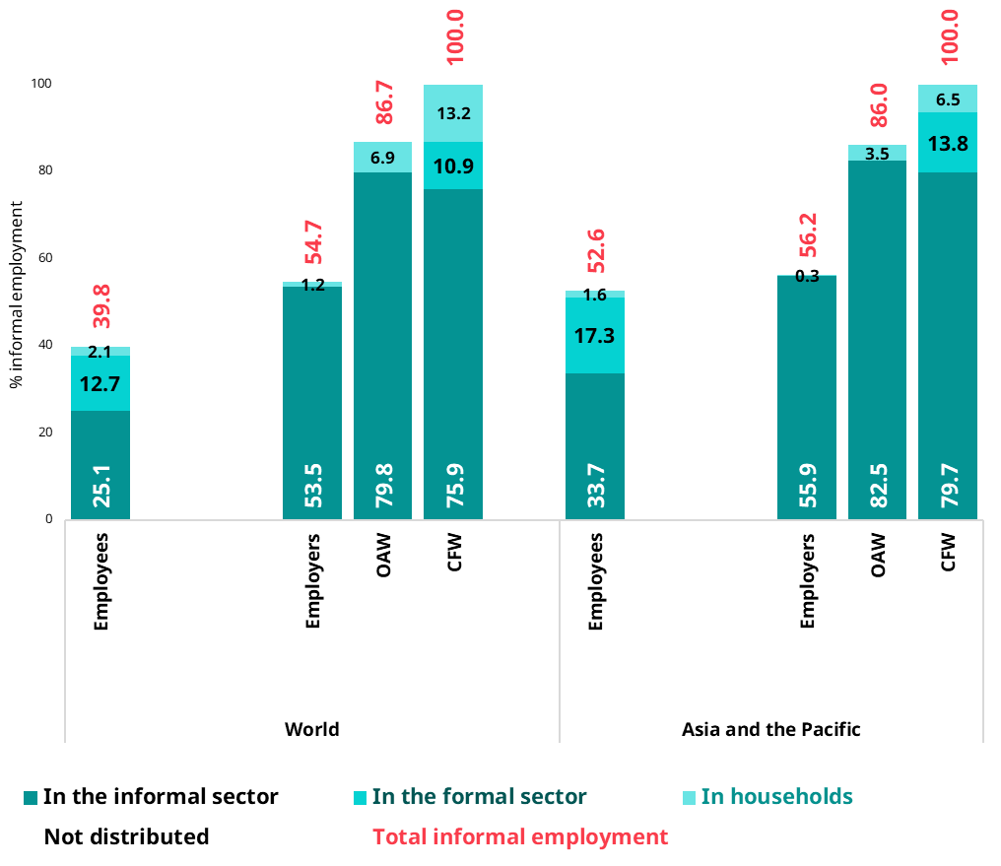
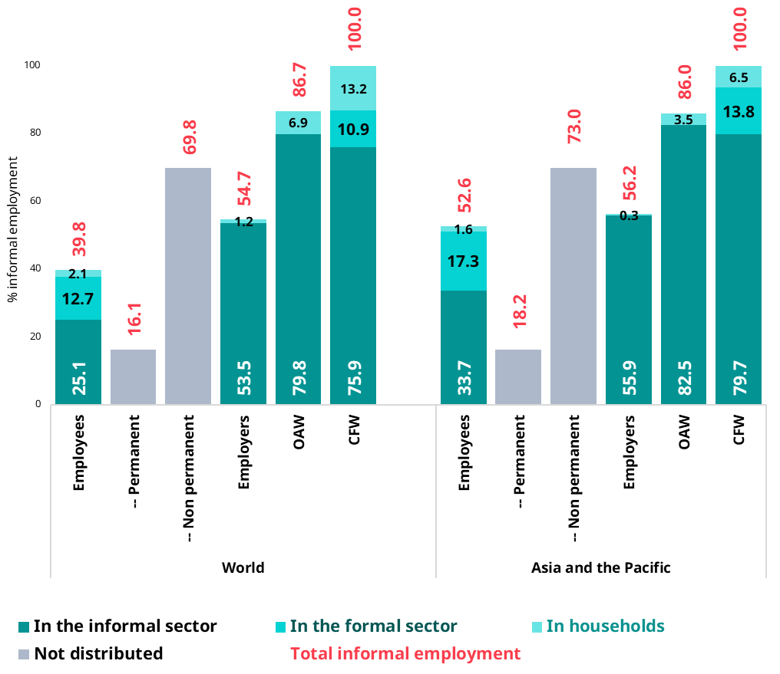
According to you, who are the workers the most exposed to and/or the most represented in informal employment (world, region or country)?
 | World |  | Region
Informal employment is… | True | False | True | False
A greater source of employment for women than for men
Higher among young workers and senior workers
Null or negligible among high educated workers
The informal economy tends to absorb people with low-education
Higher among independent workers compared to wage workers
Independent workers make up the majority of informal employment
Workers in large enterprises are “safe” & protected against the risk of being informally employed
Agriculture, domestic work & construction tend to be highly informal
Share of informal employment in total employment by status in employment | (World, Asia and the Pacific)
See indicators 15 & 25 in Country profiles
3. Exposure to informality

Slide 21
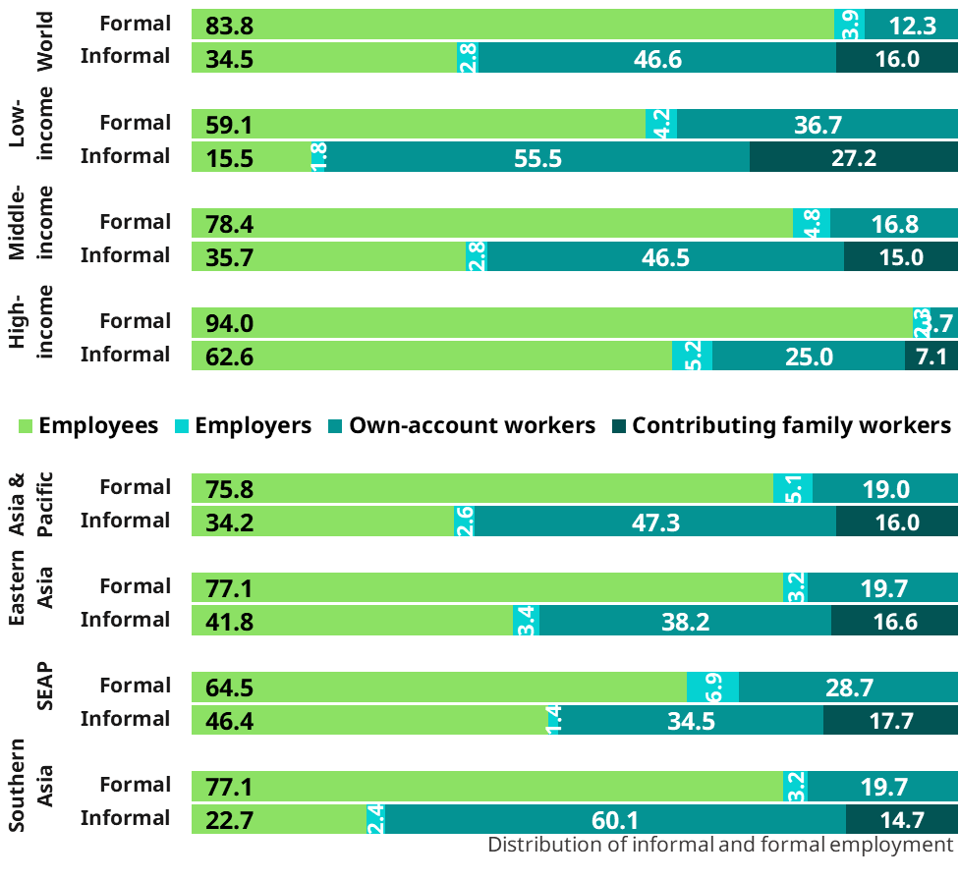
According to you, who are the workers the most exposed to and/or the most represented in informal employment in the selected countries?
Own-account workers make up 47% of informal employment & contributing family workers 16%  Vulnerable
Employees represent 35% of all workers in informal employment
  The proportion of employees increases with the level of development
 | World |  | Region
Informal employment is… | True | False | True | False
A greater source of employment for women than for men
Higher among young workers and senior workers
Null or negligible among high educated workers
The informal economy tends to absorb people with low-education
Higher among independent workers compared to wage workers
Independent workers make up the majority of informal employment
Workers in large enterprises are “safe” & protected against the risk of being informally employed
Agriculture, domestic work & construction tend to be highly informal
Distribution of informal and formal employment in total employment by status in employment | (World, Asia & the Pacific)
In low-income countries
Over 80% of total informal employment is composed of contributing family workers & own-account workers
More than 90% of informal employment is in the informal sector
Agriculture represents 68% of total informal employment
In middle-income countries
Informal employment is still dominated by independent workers but…
… informal wage employment is a sizeable share of total informal employment
Lower share of agriculture (<40%) and services represent 35%
In high-income countries
Undeclared employees is an important manifestation of informal employment: >50%
and self-employment includes a significant proportion of misclassified self-employment
See indicator 7 in Country profiles
2. Composition of informality

Slide 22
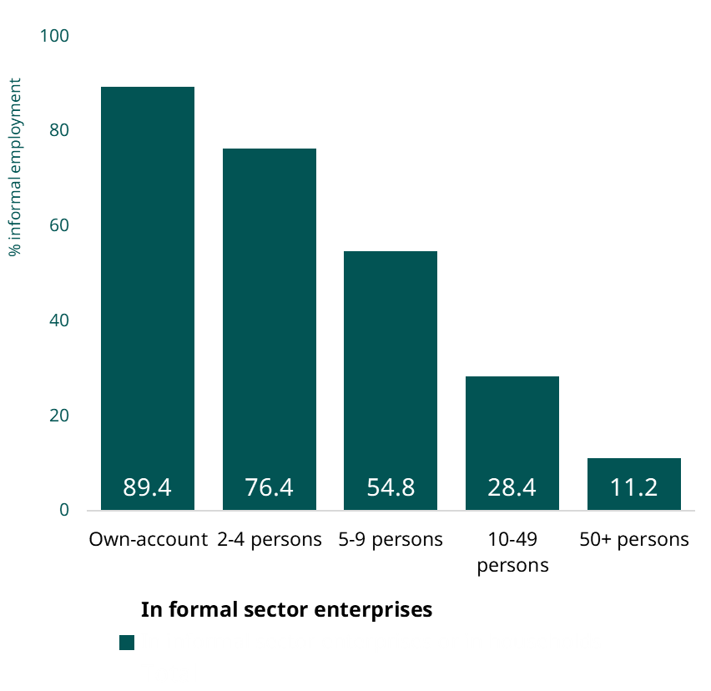
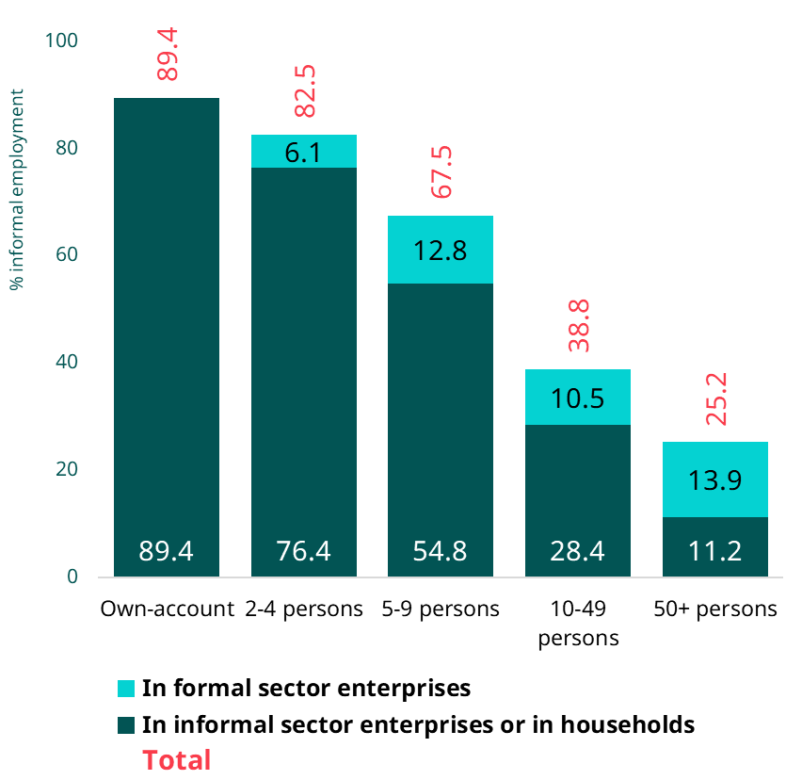
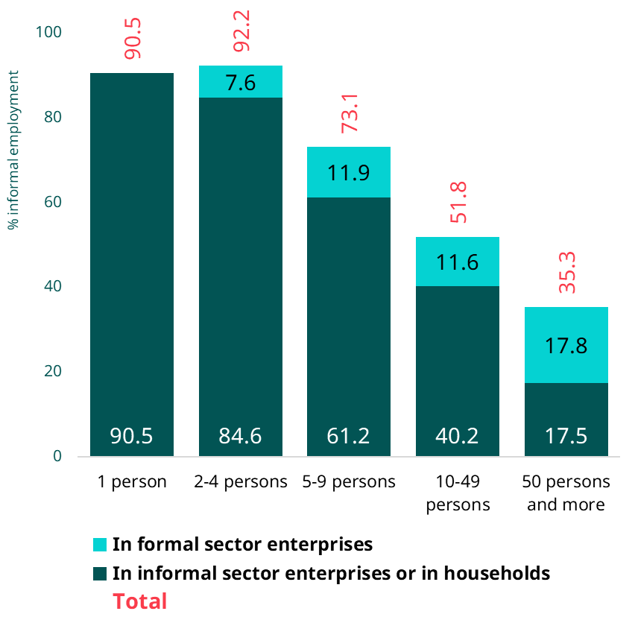
According to you, who are the workers the most exposed to and/or the most represented in informal employment in the selected countries?
 | World |  | Region
Informal employment is… | True | False | True | False
A greater source of employment for women than for men
Higher among young workers and senior workers
Null or negligible among high educated workers
The informal economy tends to absorb people with low-education
Higher among independent workers compared to wage workers
Independent workers make up the majority of informal employment
Workers in large enterprises are “safe” & protected against the risk of being informally employed
Agriculture, domestic work & construction tend to be highly informal
Incidence of informal employment by size of enterprise | (World, Asia and the Pacific)
See indicators 8 in Country profiles
Asia and the Pacific
World
In informal sector enterprises or in households
3. Exposure to informality

Slide 23
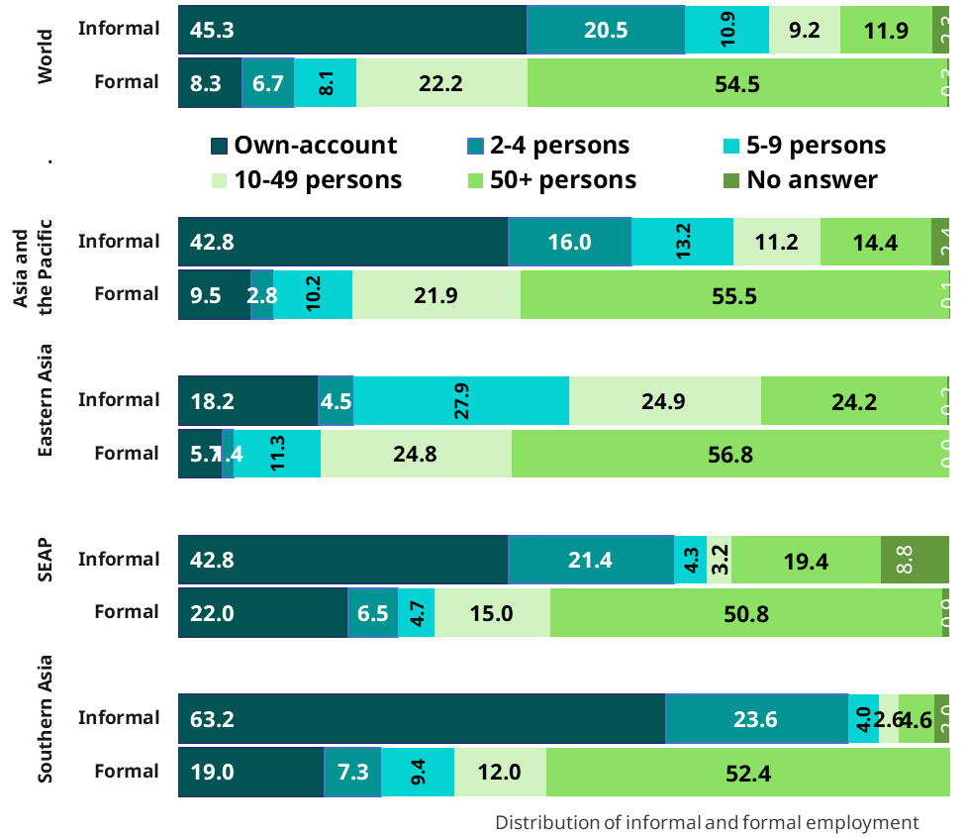
According to you, who are the workers the most exposed to and/or the most represented in informal employment in the selected countries?
 | World |  | Region
Informal employment is… | True | False | True | False
A greater source of employment for women than for men
Higher among young workers and senior workers
Null or negligible among high educated workers
The informal economy tends to absorb people with low-education
Higher among independent workers compared to wage workers
Independent workers make up the majority of informal employment
Workers in large enterprises are “safe” & protected against the risk of being informally employed
Agriculture, domestic work & construction tend to be highly informal
Distribution of informal and formal employment by size of enterprise | (World, Asia and the Pacific, Pakistan)
See indicators 18 in Country profiles
2. Composition of informality

Slide 24
The sectoral dimension of informality |
Indicators to support the adoption of a sectoral approach
    The sectoral dimension of informality
          Arguments for the adoption of a sectoral approach for formalization benefiting from structures and actors active in particular sectors.
          Using ISIC 2 digits (at least) allows to point out to the situation of particular groups of workers (e.g. Domestic workers)
    Criteria that may be considered to select subsectors
          Priority sectors in national development strategies
          Sectors the most exposed to informality
          Sectors the most represented among those in informal employment (next slide)
          Sectors with high representation of certain vulnerable groups (e.g. migrant workers, seasonal workers in agriculture or construction)
          Sectors with good opportunities to succeed in terms of formalization and reduction of decent work deficits: « show case»

Slide 25
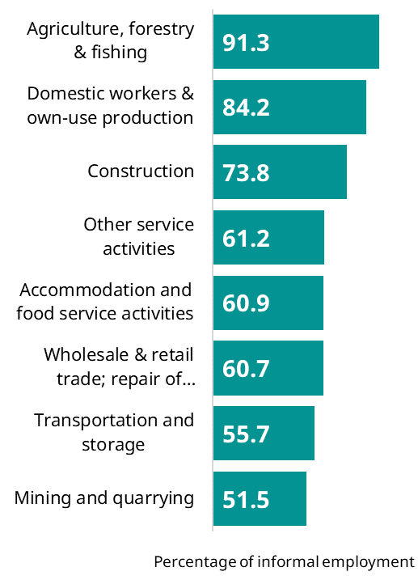
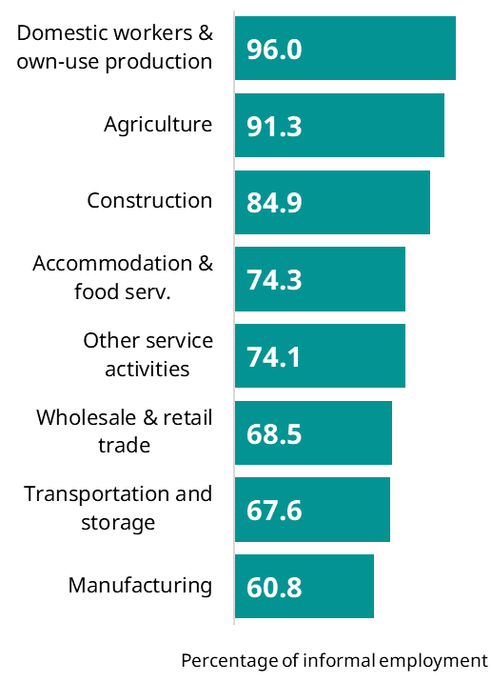
According to you, who are the workers the most exposed to and/or the most represented in informal employment in the selected countries?
 | World |  | Region
Informal employment is… | True | False | True | False
A greater source of employment for women than for men
Higher among young workers and senior workers
Null or negligible among high educated workers
The informal economy tends to absorb people with low-education
Higher among independent workers compared to wage workers
Independent workers make up the majority of informal employment
Workers in large enterprises are “safe” & protected against the risk of being informally employed
Agriculture, domestic work & construction tend to be highly informal
The 8 economic sectors the most exposed to informality | ASAP, Pakistan
See indicators 16 in Country profiles
World
Asia and the Pacific

3. Exposure to informality


Slide 26
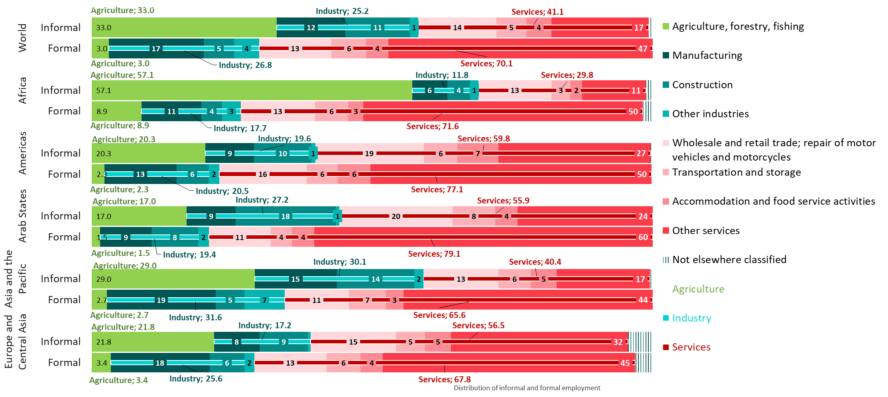
The sectoral dimension of informality |
What are the sectors the most represented?
2. Composition of informality
Distribution of informal and formal employment by sector of activity (%, 2019)
For specific country data, see indicator 11 (composition) in country profiles

Slide 27
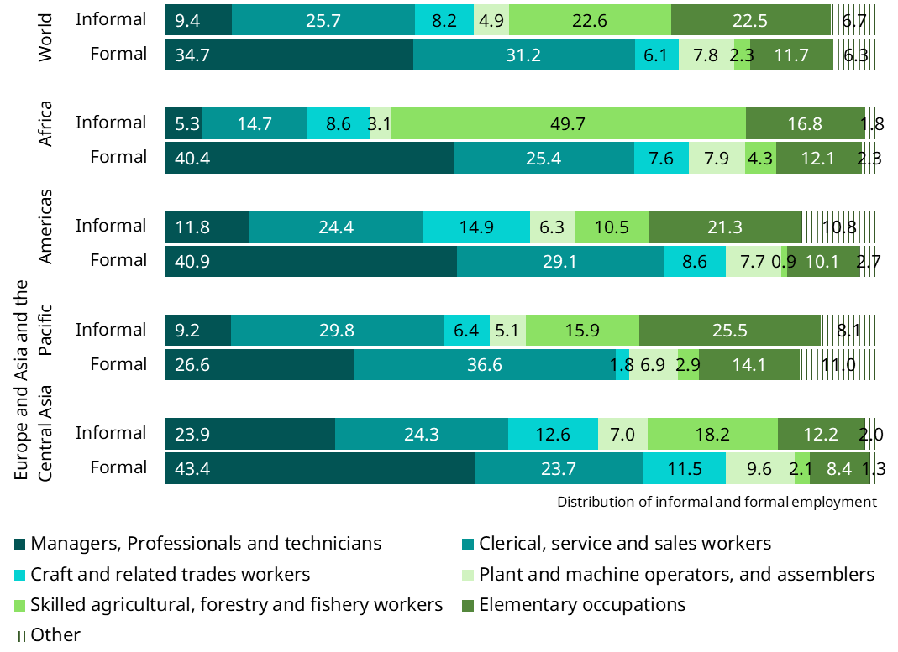
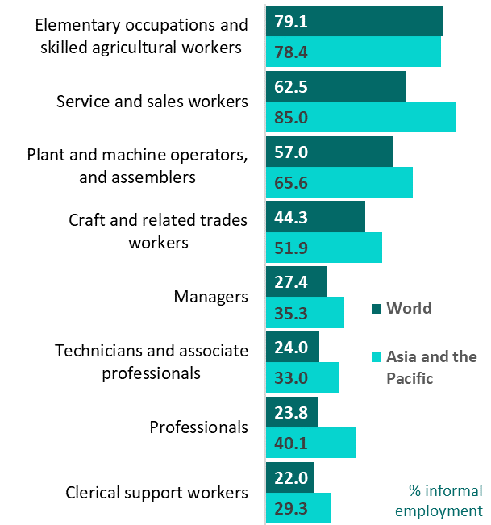
Occupations & informality
World:
Elementary occupations and skilled agricultural workers represent close to one in two workers in informal employment (more than 3 times their representation among formal workers)
Worldwide, 1/3 of workers in formal employment are either managers, professionals or technicians; 1 out of 4 in Asia and the Pacific
Occupational profiles of workers in informal and formal employment differ the most in Africa and the least in Europe and Central Asia
3. Exposure to informality
2. Composition of informality
Percentage informal employment by occupation (%, 2019)
Distribution of informal and formal employment by occupation (%, 2019)
See indicators 11 (composition) & 17 (exposure) in country profiles

Slide 28
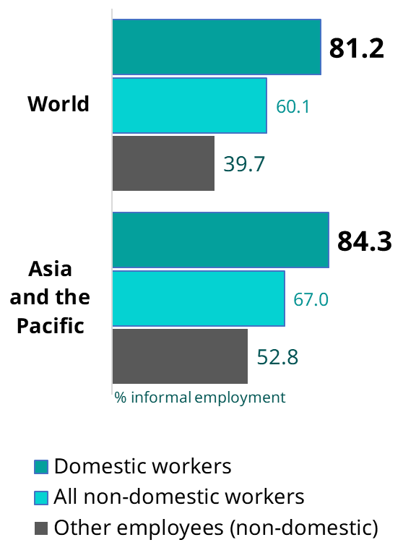
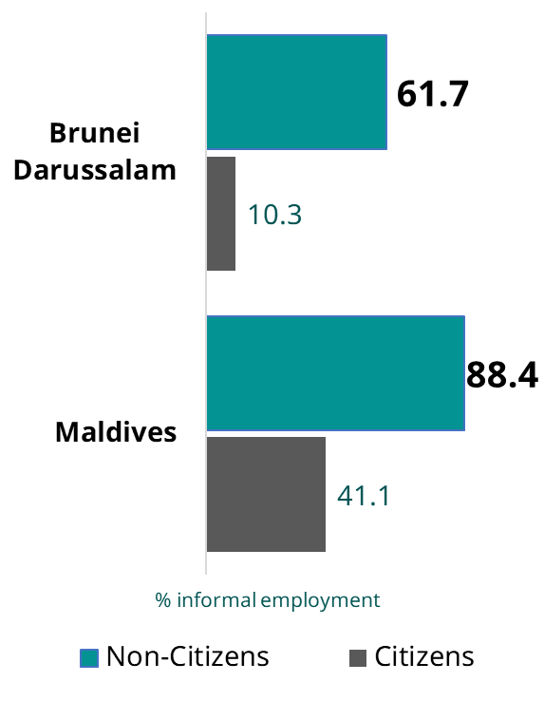
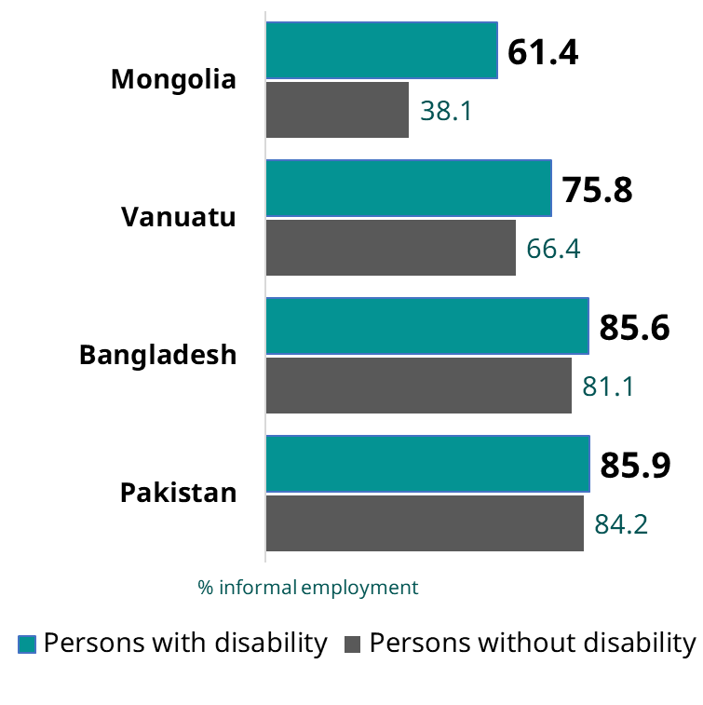
Exposure to informality of other specific groups of workers
3. Exposure to informality
Percentage of informal employment among some vulnerable groups
Domestic workers
Citizens/ Non-citizens
Persons with and without disabilities
Sources: Graph 1: ILO 2021. Making decent work a reality for domestic workers; Graph 2: Maldives HIES 2019; Brunei LFS 2023; Graph 3. Mongolia LFS 2023, Vanuatu HIES 2019, Bangladesh LFS 2022, Pakistan LFS 2021.

Slide 29
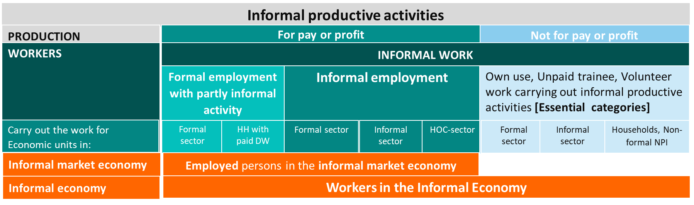
Indicators referring to persons/jobs and work activities
Partly informal productive activities [§134]

Slide 30
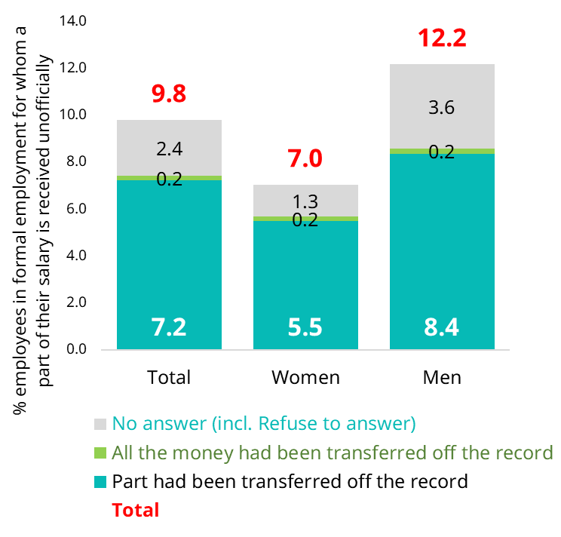
Partly informal productive activities carried out by persons
Partly informal activities
Para 134
A. Extent of informal work activities
Russian Federation | 134a. Percentage of employees in a formal main job where a part of the paid hours and earnings is not declared for taxation or mandatory job-related social security contributions, by sex (%, Russia Longitudinal Monitoring Survey (RLMS) 2019)
Main dimensions
1. Extent of informality
Objectives
  Assess the incidence among persons in formal employment of under-declaration of hours worked and income; and the volume/value of undeclared hours/income
Situation
  Only a limited number of countries currently assess ‘partly informal activities’ [Ex. whether part of the salary is paid unofficially (envelope wages) + share of the salary received unofficially]
  Will benefit from experience
  Of particular relevance in high income countries
Indicators
  2 indicators refereeing to persons in formal employment carrying out partly informal productive activities
  2 indicators on the volume/ value of undeclared hours / income
1. Extent of informality
2. Composition of informality
  134a. Percentage of employees in a formal main job where a part of the paid hours and earnings is not declared for taxation or mandatory job-related social security contributions.
  134b. Volume or value of partly informal paid hours from employees in a formal main job.
  134c. Percentage of respectively independent workers and dependent contractors in a formal main job where part of their income is not declared for taxation.
  134d. Value of partly informal productive activities carried out by independent workers and dependent contractors in relation to formal main jobs
3. Exposure to informality
4. Working conditions & productivity
5. Contextual vulnerability
6. Other structural factors

Slide 31
Indicators referring to persons/jobs and work activities
Essential categories of informal work other than employment [§135]

Slide 32
Reference unit: Work activities — Essential categories of informal work other than employment
Work activities
Para 135
A. Extent of informal work activities
Main dimensions
In addition, some indicators are included to describe the essential categories of informal unpaid work i.e.
Informal subsistence work
Informal unpaid trainees
Important to complement the estimate on informal employment in countries where those categories are significant
Objectives
  Complements the estimate of informal employment (notably by assessing the extent of subsistence food-stuff producers)
  Complements the analysis of paid trainees and assess the representation and distinct characteristics and working conditions of paid versus unpaid trainees respectively
  Of particular relevance in countries where subsistence foodstuff producers or unpaid trainees are significant
Indicators in the resolution
  Indicators in relation to informal subsistence work
  Indicators in relation to informal unpaid trainees
  + to be developed in relation to unpaid care work
1. Extent of informality
1. Extent of informality
2. Composition of informality
3. Exposure to informality
  135a. The number of informal subsistence foodstuff producers and percentages in relation to: (i) the sum of informal employment and subsistence foodstuff producers; and (ii) total employment and subsistence foodstuff producers
  135b. The number of informal unpaid trainees and percentage in relation to total unpaid trainees.
  135c. The number of informal trainees, paid and unpaid, and percentage in relation to total trainees, paid and unpaid
4. Working conditions & productivity
5. Contextual vulnerability
6. Other structural factors
Unpaid work

Slide 33
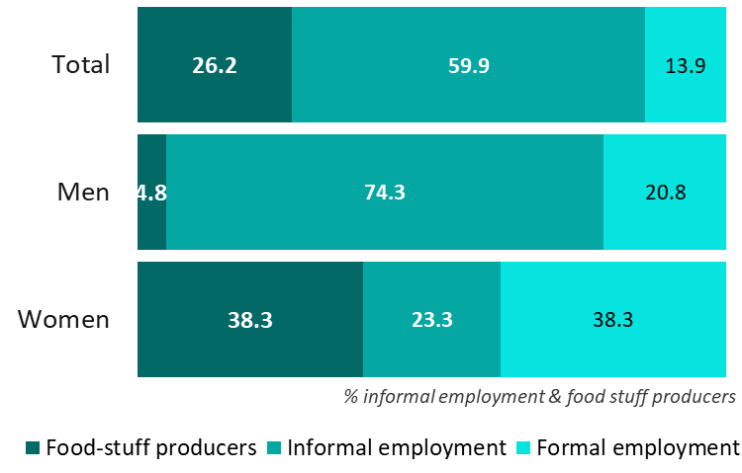
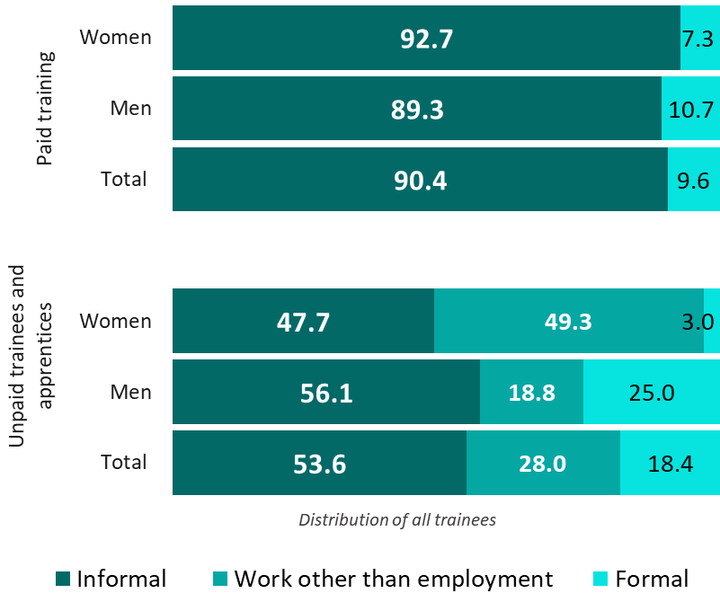
Reference unit: Work activities — Essential categories of informal work other than employment
Work activities
Para 135
Bangladesh | Informal subsistence food-stuff producers — percentage in relation to total employment and subsistence food-stuff producers by sex (LFS, 2022)
Bangladesh | Percentage of informal trainees, paid and unpaid, in relation to total trainees, paid and sex (LFS, 2022)
1. Extent of informality
1. Extent of informality
2. Composition of informality
3. Exposure to informality
4. Working conditions & productivity
5. Contextual vulnerability
6. Other structural factors
Unpaid work
See indicators 37 in country profiles
135a
135c

Slide 34

Group work
Compute indicators on the size and structure of informal employment | Abelina case

Slide 35
Case study | Abelina
Statistics on the informal economy as a basis for the definition of policies
In 2015, representatives from the government of Abelina and social partners had voted in favour of Recommendation 204 on the transition from the informal to the formal economy and committed themselves to facilitating this transition in Abelina.
The Ministry of Labour and social partners have to present some first results of the diagnostic of informality in Abelina at the Global Forum on Formalization in a month's time.
David Swift and his team (you!) are responsible for the quantitative overview.
The Ministry of labour commissioned in parallel a study on the main drivers of informality as part of the legal and institutional frameworks. They should share shortly some preliminary elements to complete the analysis of the main indicators.
In relation to the quantitative part, we are counting on you for the analysis of the extent, exposure to and composition of informal employment in Abelina.
You will work on the first block of indicators and David will prepare additional indicators including on working conditions.

Slide 36
Case study | Abelina
Dear all
I´m expected to prepare for early next week the quantitative component of what will be the first diagnostic of informality in Abelina. This is a request from the Government representatives and social partners who will be participating to the Global Forum on formalization in a month's time.
I have prepared an excel file (attached) with basic data for Abelina following our definition of informal employment and informal sector.
I would very much like you all to prepare some of the key indicators on the size and the structure of informal employment in Abelina.
Explanations and detailed questions are provided in the file but if you have any question, please contact me or Florence, my assistant.
Best regards
David Swift
@
You received the following email with an excel file attached with the main data on informal employment and informal sector in Abelina but also for a set of other countries for comparison.

Slide 37
Group work: Extent, composition of & exposure to informal employment in Abelina
Main indicators on the size and structure of informal employment
Open the excel file called ‘Session 3.1 - Indicators Group Work (without solutions)’
  Guidance and questions: “3.1 - GroupWork”
  1 data sheet : DATA ALL (Protected sheet)
    Data from Abelina and other countries for comparison
  3 blue sheets to be used to calculate indicators (using data from DATA ALL)
    QUESTIONS 1-2
    QUESTION 3
    QUESTION 4
  3 Green sheets with graphs and indicators updated automatically (Protected sheets)
    Graphs % informal employment
    Graphs Gender dimension
    Graphs Composition informal

Slide 38
Group work: Extent, composition of & exposure to informal employment in Abelina
DATA ALL:
  DATA ALL is the source of data to be used to calculate indicators in the “blue sheets”
Structure of Data ALL
  For each country (column B), you can find the number of workers — Total and by employment status (Column C) — in:
    Informal employment (columns D-G)
      Total (D); in the informal sector (E); in the formal sector (F); in Households (G)
    Formal employment (Columns I-L)
    Total employment (Columns N-Q)
    The remaining columns correspond to the same set of data but respectively for
      Men (columns S-AF)
      Women (columns AH-AU)

Slide 39
Group work: Extent, composition of & exposure to informal employment in Abelina
Assess the extent and structure of informal employment:
  Using data in Data ALL
  Question 1 Can you estimate for Abelina
    Indicator 1. The share of informal employment in total employment
    Indicators 2 & 3: the same indicator for women and men (from Data ALL)
    Could you identify countries where women are more exposed than men to informal employment? What is the situation in Abelina and what do you think could be the reasons?
    What can you say about the % of informal employment and income groups of countries?
  Question 2: “Who are the most exposed”? Can you estimate the percentage of informal employment respectively for employees, employers and own-account workers
    Indicator 4. Share of informal employment among employees
    Indicator 5. Share of informal employment among employers
    Indicator 6. Share of informal employment among own-account workers
    Please, analyse and comment the main results considering Abelina and other countries

Slide 40
Group work: Extent, composition of & exposure to informal employment in Abelina
Question 3: Distribution by employment status: “Who are the most represented?”
Can you calculate:
  The distribution of informal employment by employment status
  The distribution of formal employment by employment status
Please, analyse and comment the main results considering Abelina and other countries
  Question 4: Composition of informal employment: most prevalent form(s) of informality and what formalization means in terms of policy for the different groups of workers?
  The objective is to estimate the proportions (as a percentage of total informal employment) of:
  Persons in informal employment in informal sector enterprises
  Persons in informal employment in formal sector
  enterprises
  Persons in informal employment in households
Discussion of results
  Can you illustrate each group with typical examples of workers
  Can you associate to each group, some examples of measures to facilitate the transition to formality (including reduction of decent work deficits) to illustrate “What formalization means may mean for them?”

Slide 41
Homework:
Read the Abelina case study
Florence Bonnet

Slide 42
Thank you !

Slide 43
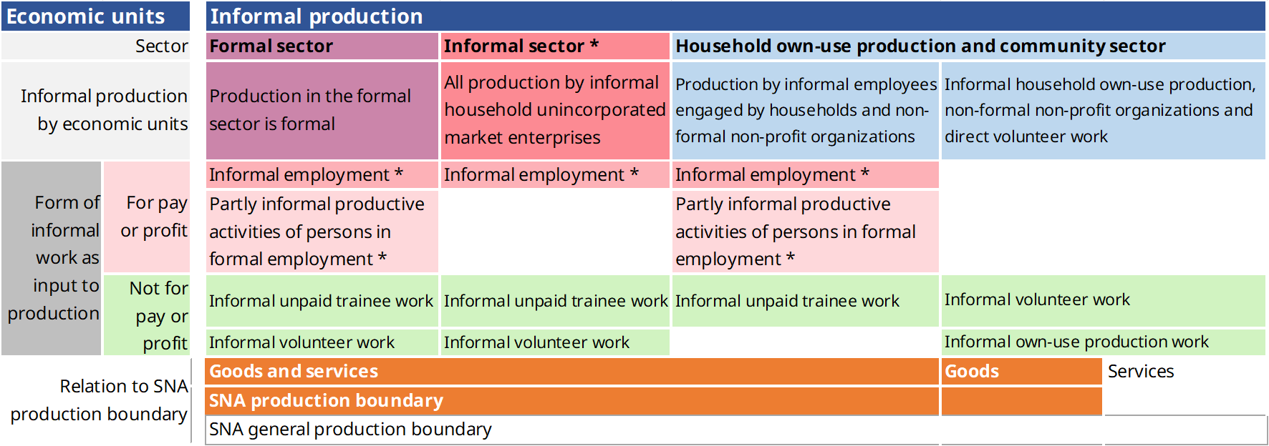
Indicators referring to economic units
Informal sector [§136]

Slide 44
Reference unit: Economic units | Introduction (1)
Informal sector
Para. 136
        The indicators referring to the informal sector are organized around the reference units of economic units.
        Indicators in the resolution reflect the extent of informal household unincorporated market enterprises; the composition of the informal sector (compared to the formal sector); the exposure to informality of different categories of economic units and productivity (of informal compared to formal economic units)
        Only a limited set of indicators included in the resolution but ample space given for additional indicators as part of the accompanying indicator framework to cover notably issues such as:
          Factors enhancing/ constraining the development of economic units and productivity, such as labour related factors, production related factors (access to property, finance, machines or equipment, etc.); business environment factors (customers, suppliers and competitors, linkages between formal/informal sector), administrative factors
          Motivation: initial motivation to create the economic unit; motivation to formalize
          Past trends, prospects and needs

Slide 45
Reference unit: Economic units | Introduction (2)
Informal sector
Para. 136
        The understanding of economic units is crucial, but data are not widely available  the inclusion of enterprise-based indicators as part of the resolution and the broader indicator framework will hopefully contribute to enhance the availability of such data.
          The majority of persons in informal employment are in the informal sector (85%)
          Importance to understand the role of formal enterprises as well as providers of decent jobs, their sustainability and capacity to grow in a manner that secures workers’ rights (including preventing informalization)
        Depending on country priorities, the set of enterprise-related indicators can be applied to all economic units or to a subset, such as micro and small economic units or economic units in a given sector

Slide 46
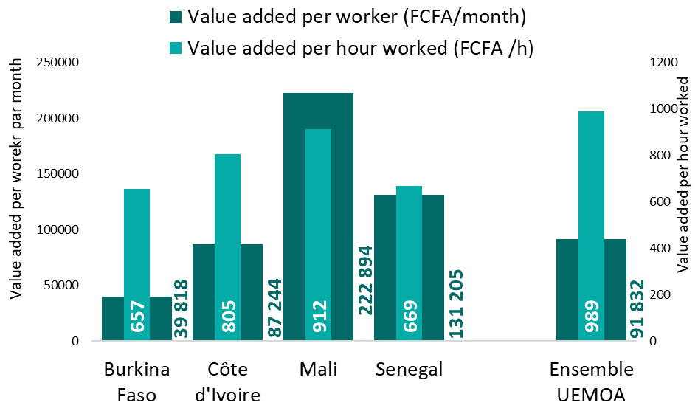
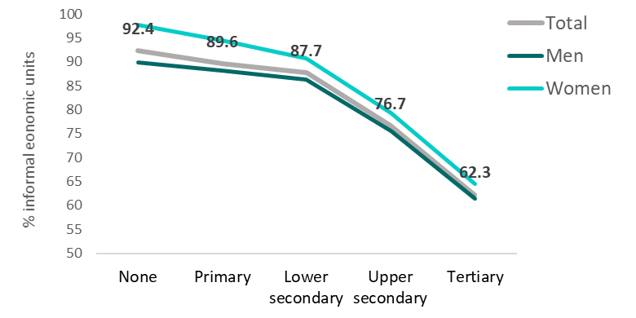
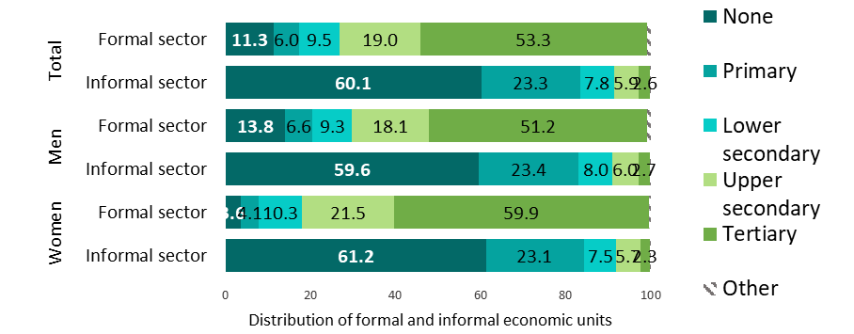
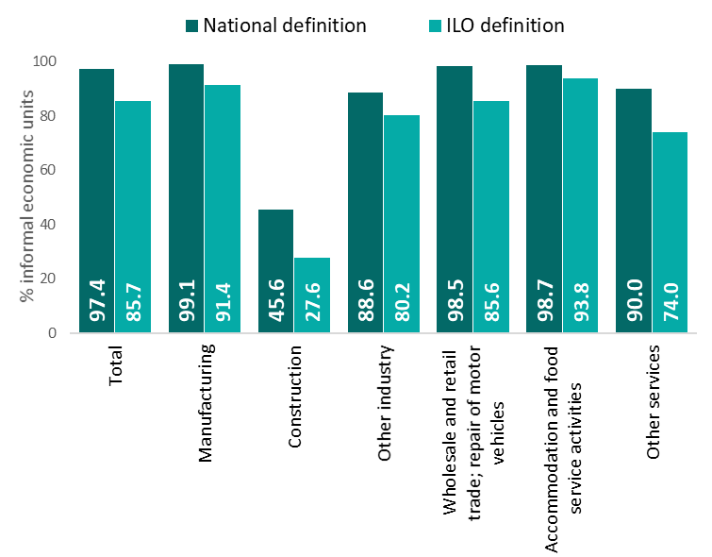
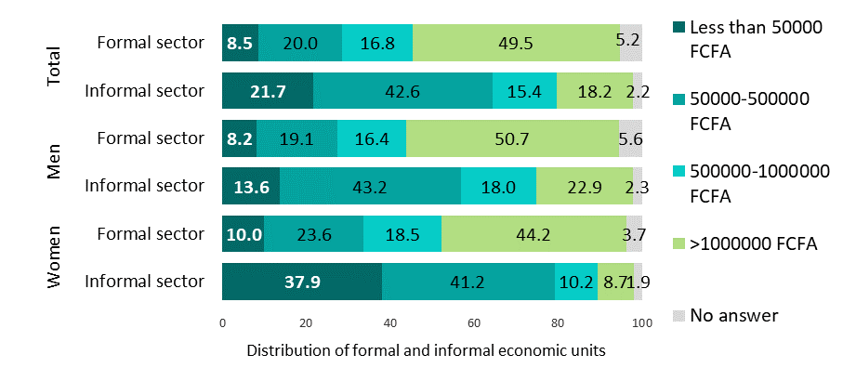
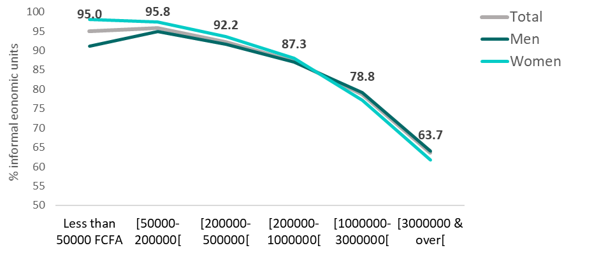
Reference unit: Economic units
Informal sector
Para. 136
A. Extent of informality
Senegal | 136b Distribution of informal household unincorporated market enterprises and formal economic units by highest level of education of the owner
(RGE 2016)
Senegal | 136c. Percentage of informal household unincorporated market enterprises in relation to highest level of education and sex of the owner (RGE 2016)
Senegal | 136a. Percentage of informal household unincorporated market enterprises in relation to the total number of economic units in the informal and formal sector, by economic activity (RGE 2016)
UEMOA | 136d. VA per worker in informal household unincorporated market enterprises (FCFA, ERI-ESI 2017-18)
136a. Assess the prevalence of informal household unincorporated market enterprises and monitor trends
Limited set of recommended indicators, capturing some of 4 out of the 6 dimensions with economic units as reference unit
Most of those indicators require the use of an establishment-based survey/census alone or combined (e.g. mixed surveys or with LFS/specialized HH surveys)
Produced with less frequency and regularity
B. Composition of informality
136b. Identify types of economic units most represented in the informal sector compared to those in the formal sector by economic unit features & by socio-demo characteristics of the owner(s)
C. Exposure to informality
Senegal | 136b. Distribution of informal household unincorporated market enterprises and formal economic units by social capital (%, RGE 2016)
136c. Identify types of economic units most exposed to informality by economic unit characteristics and by socio-demographic characteristics of the owner(s)
Senegal | 136c. Percentage of informal household unincorporated market enterprises in relation to social capital (RGE 2016)
Source: ERI-ESI in UEMOA Member States, 2017-2018
Note: Focus on informal sector units (in phase 2) with no comparison possible with formal sector units.
D. Working conditions/ productivity
136d. Value added/output in informal household unincorporated market enterprises compared to formal economic units per worker, by eco. activity
Dimension A
Dimension B
Dimension C
Dimension D
136a
136b
136c
136d

Slide 47
Dimension 4. Productivity and economic performance of economic units
Main dimensions
Economic units and contribution to the economy
1. Size and trend of informality
7. The spatial
dimension
  (Labour?) Productivity by size (number of workers) of economic units and sector
  Factors enhancing/ constraining the development of eco. units and productivity:
      Labour related factors: composition of employment within the economic unit + working conditions (covered above);
      Production related factors:
        Access to property, place of work, …
        Access to finance: source of financing; indebtedness
        Access to machines or equipment; supply of raw materials
      Business environment factors: customers, suppliers and competitors, linkages between formal/informal sector
      Administrative factors
  Motivation: initial motivation to create the economic unit; motivation to formalize
  Past trends, prospects and needs
2. Composition of informality
3. Exposure to informality
?
4. Working conditions & productivity
5. Contextual vulnerabilities
6. Others factors structural

Slide 48
Indicators referring to economic units and productive activities of persons
Contribution of the informal economy to GDP [§137-138]

Slide 49
Reference unit: economic units and productive activities of persons
Informal economy
Para. 137
        137. The types of indicators covering the contribution of the informal economy to GDP are organized around the reference units of economic units and productive activities of persons.
        They reflect the extent of the informal production
        The indicators included in the resolution proposed to cover the following components of the contribution of the informal economy (within SNA production boundary) to GDP:
137c)
137a)
137b)
        137a. Contribution of the informal sector to GDP, by economic activity.
        137b. Contribution of informal production in the household own-use production and community sector to GDP (within the SNA production boundary)
        137c. Contribution to the production by economic units in the formal sector of:
          informal employees
          formal employees carrying out partly informal productive activities
          persons carrying out informal work other than employment

